Slide 1


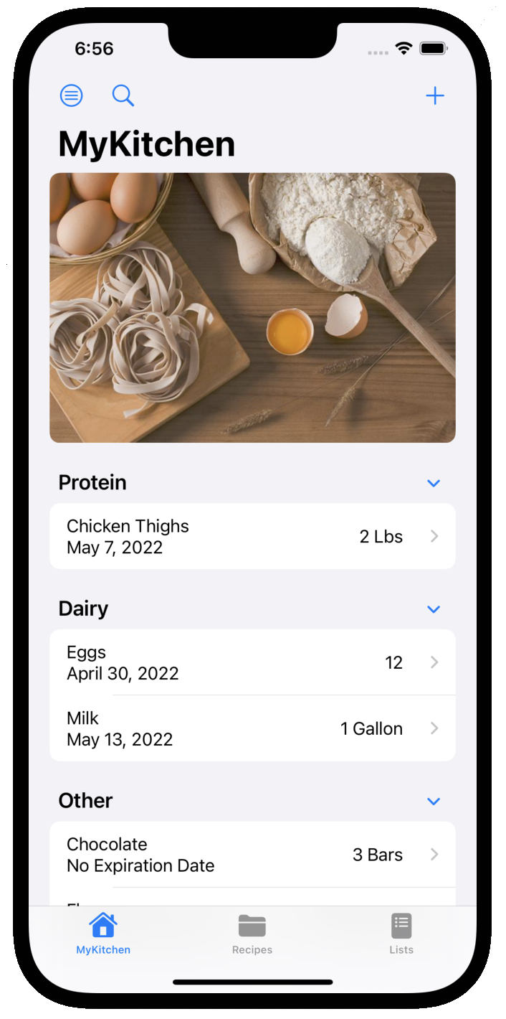
MyKitchen
Elliott Gorman Garrett Griffiths Krish Suchdev Rowenna Switzer Thinh Le
Goal: Create a mobile app that enables users to efficiently maintain a running inventory of their food items, recipes, and shopping lists.
Approach: Standalone application to be paired with existing APIs
SwiftUI backend
Grocery APIs
Barcode API
Features:
MyKitchen Tab – Manage and view food inventory
Barcode scan or manual entry for new items
Search/ filter items by location or category
Recipes Tab – Add and follow personal recipes
App lets you know if you’re missing ingredients
Generate & export shopping list to pull what ingredients are not in stock
Smart Shopping Lists Tab – Create and manage lists for different stores
Easy transfer into food inventory once purchased

